Slide 1
Cyclistic — Member vs. Casual Rider Analysis
Capstone case study — Cyclistic bike-share (Jan–Apr 2021 subset)
Presented By : Harsh RG
Date – 02/10/2025
Notes:
Hello everyone, today I’ll be presenting my capstone project on Cyclistic’s bike-share program. The focus of this project is to analyze the differences in how annual members and casual riders use Cyclistic bikes, and how these insights can help design strategies to convert casual riders into annual members.

Slide 2

AGENDA
Introduction & Business Task
Key Questions (Ask Phase)
Data Collection & Cleaning (Prepare + Process)
Usage Analysis (Analyze Phase)
Insights & Business Recommendations (Share Phase)
Notes:
This presentation will follow the structure of the data analysis process. First, I’ll introduce the business problem. Then we’ll look at the key questions that were framed in the Ask phase. Next, I’ll describe the data we worked with and the cleaning steps taken. After that, we’ll dive into the analysis of rider usage patterns. Finally, I’ll summarize the insights and present actionable recommendations for Cyclistic.

Slide 3
Introduction & Business Task
Cyclistic operates a bike-share program in Chicago.
Goal: Convert casual riders into annual members.
Marketing team needs data-driven insights into rider behavior.
Notes:
Cyclistic is a bike-share company operating in Chicago. The company has two main customer groups—casual riders and annual members. The business goal is to increase the number of annual memberships, since members generate more consistent revenue. To support this, the marketing team needs insights into how these two groups behave differently, so that strategies can be designed to convert casual riders into members.

Slide 4


Key Questions (Ask Phase)
How do members and casual riders use Cyclistic differently?
Why might casual riders upgrade to annual membership?
How can Cyclistic use digital channels to encourage conversions?
Notes:
In the Ask phase, we defined three key business questions:
How do annual members and casual riders use Cyclistic bikes differently?
Why would casual riders choose to upgrade to annual memberships?
And finally, how can Cyclistic use digital media campaigns to encourage casual riders to become members? Answering these questions will guide the entire analysis process and shape our final recommendations.

Slide 5
Data Sources & Cleaning (Prepare + Process)
Data: Jan–Apr 2021 Cyclistic trip records
Processed in R (tidyverse, lubridate, janitor)
Steps:
Removed invalid/duplicate trips
Converted timestamps
Calculated ride length
Added day-of-week, month, and ride type
Notes:
Our dataset contains Cyclistic trip data from January to April 2021. The data was processed in R using packages such as tidyverse, lubridate, and janitor. Cleaning steps included removing invalid or duplicate rides, converting timestamps, calculating ride length in minutes, and adding grouping variables like day of the week, month, and ride type. These steps ensured the data was consistent and ready for analysis.

Slide 6
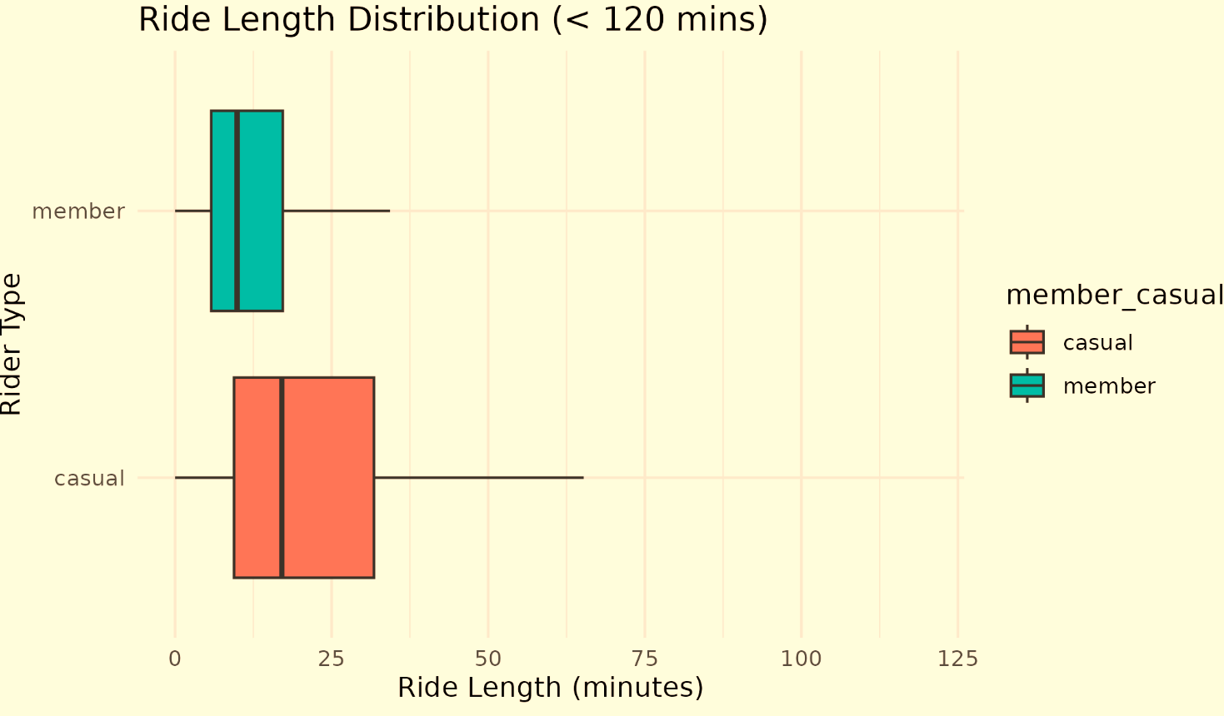
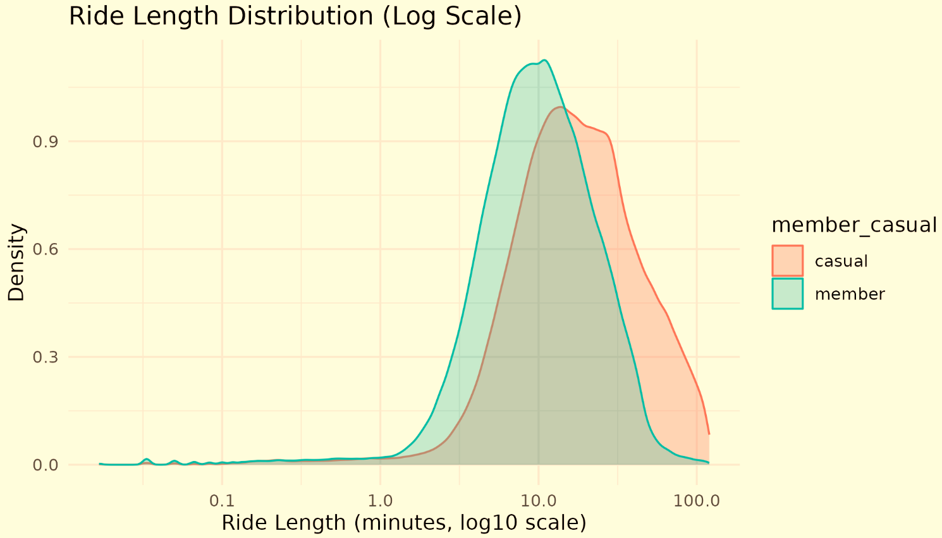
Ride Length Analysis
Boxplot & log-scale density plots
Insight: Casual rides are longer on average; members take shorter, more consistent rides.
Notes:
This slide shows how ride lengths differ between members and casual riders. The boxplot reveals that casual riders take longer trips on average, while members’ trips are much shorter and more consistent. The log-scale density plot further supports this by showing the distribution of ride lengths. This suggests that casual riders use the bikes more for leisure, while members use them more for short, routine travel.

Slide 7
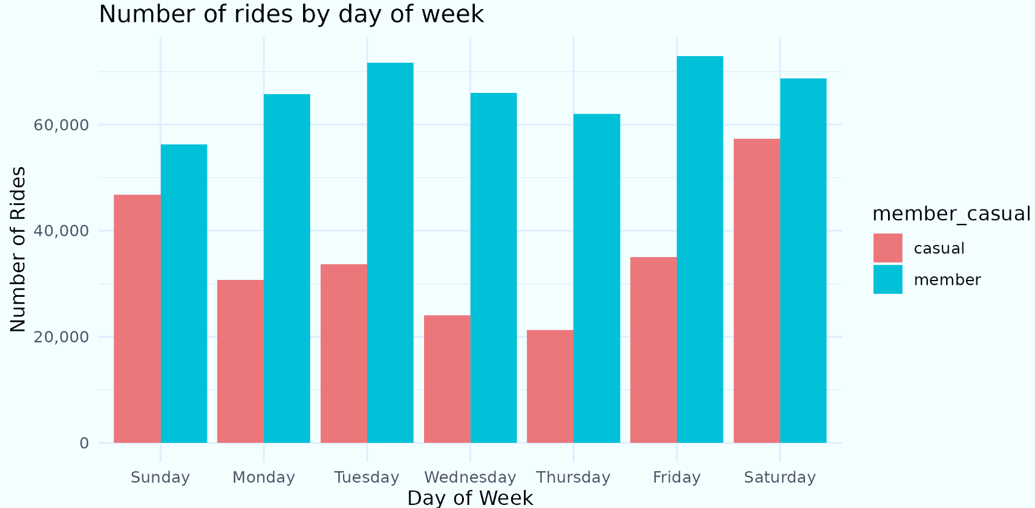
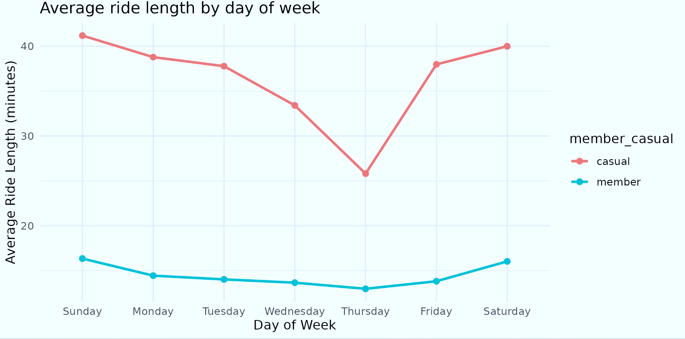
Day-of-Week Trends
Members ride more on weekdays (commuting pattern) with shorter and consistent trips.
Casual riders ride more on weekends and for longer trips.
Notes:
When we look at rides by day of the week, a clear pattern emerges. Members tend to ride more during weekdays, likely due to commuting or daily routines. In contrast, casual riders ride more often on weekends, and their rides are significantly longer. This highlights a key difference: members use bikes for utility, while casual riders use them for recreation.

Slide 8
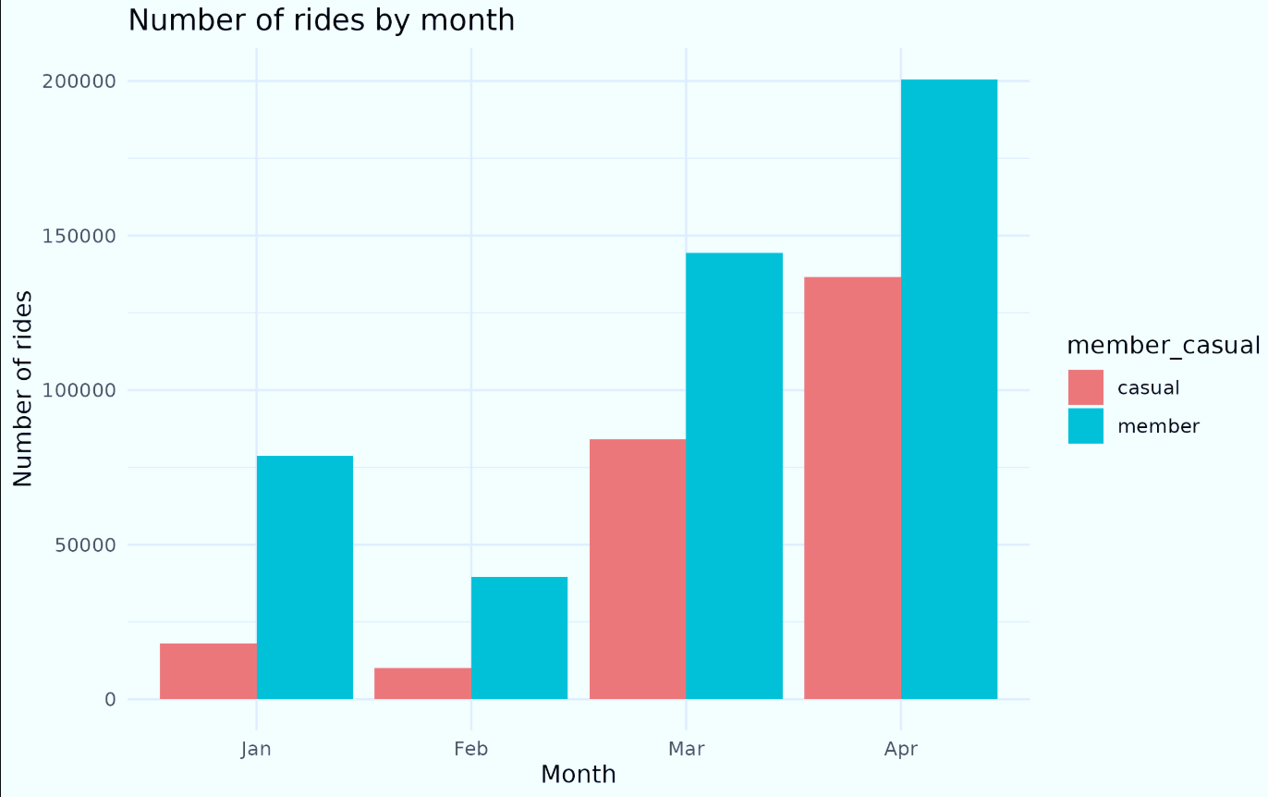
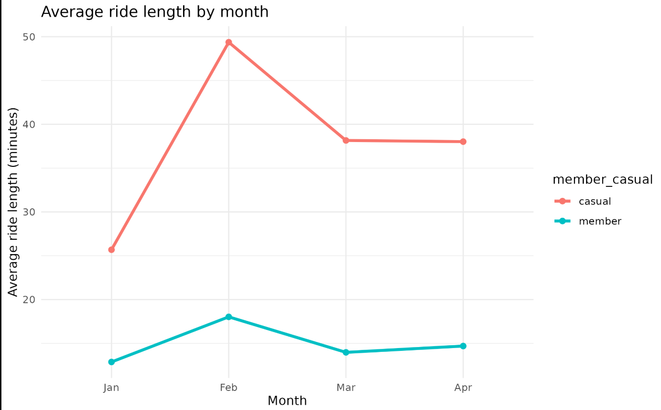
Monthly Trends
Both groups increase rides during spring (Mar–Apr).
Casual riders ride more on weekends and for longer trips.
Notes:
Looking at the data across months, we see that usage increases as the weather warms from January to April. This applies to both casual riders and members. However, casual riders consistently take longer trips across months, again suggesting more leisure-oriented behavior. For Cyclistic, this means there are seasonal opportunities to promote memberships, especially as ridership grows in spring and summer.

Slide 9
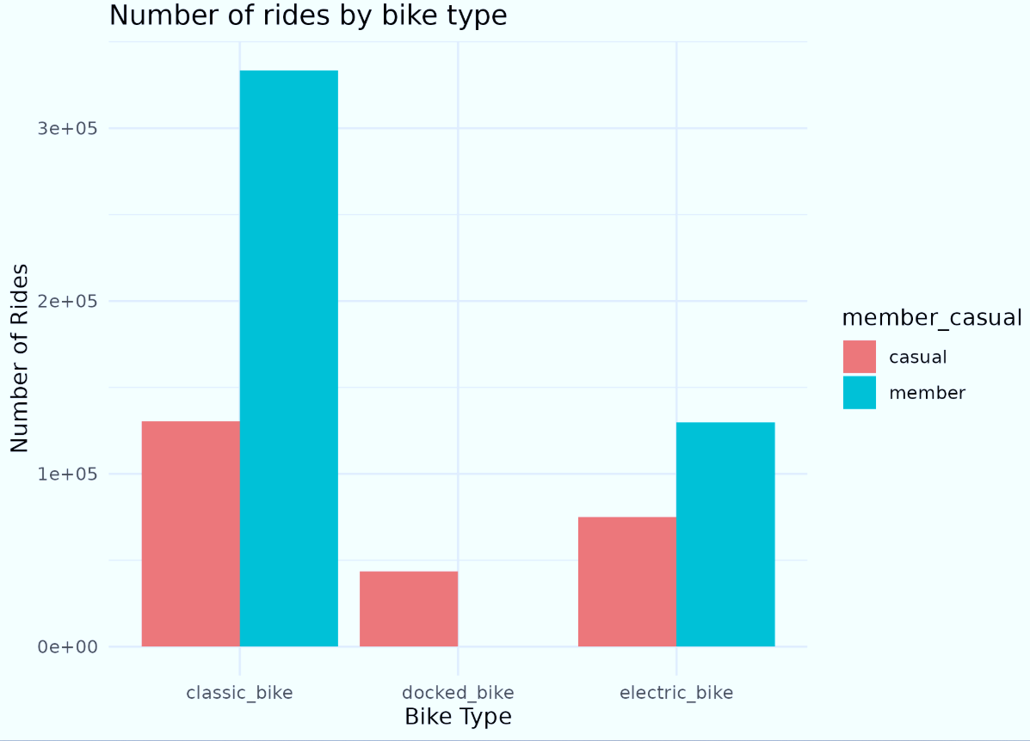
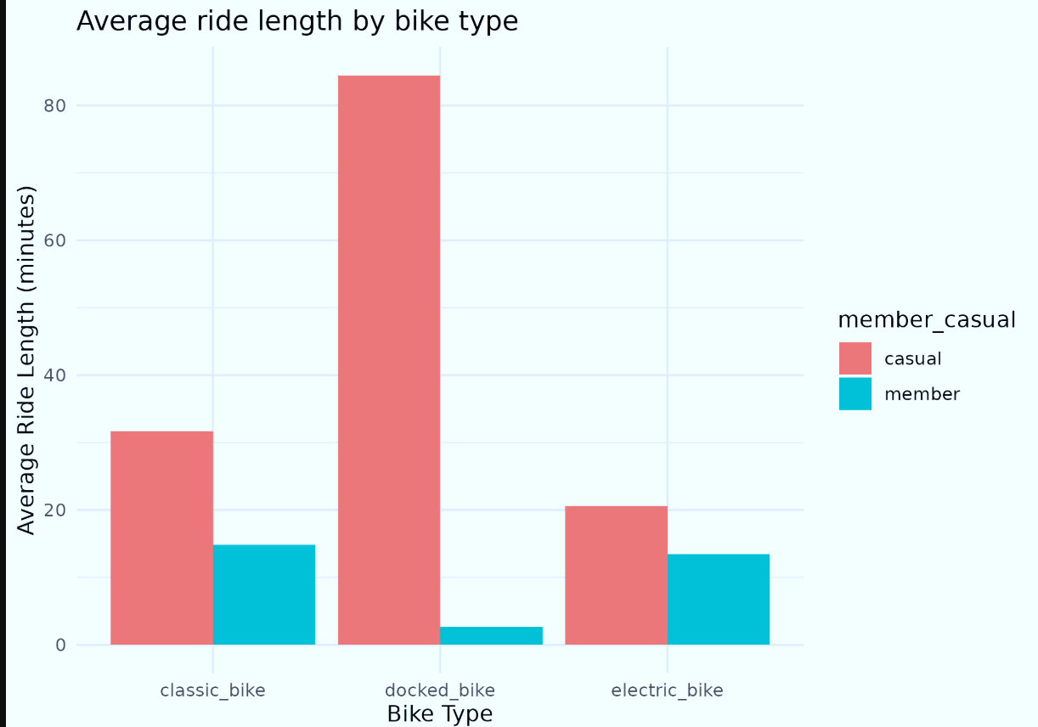
Bike Type Preferences
Members prefer classic bikes and electric bike compared to Casual riders.
Casual riders use docked bikes more and have longest average trip lengths.
Notes:
This analysis shows differences in bike type preferences. Members strongly prefer classic bikes, while casual riders are more likely to use docked bikes. Interestingly, casual riders using docked bikes also have the longest average trip durations. This tells us that casuals might choose bikes that allow for more flexible or leisurely trips, while members prefer efficiency.

Slide 10
Summary of Findings
Total rides (e.g., Members: ~463k; Casuals: ~248k)
Avg ride length (Members ≈ 14 min; Casuals ≈ 30 min)
Median ride length (Members ≈ 9–10 min; Casuals ≈ 17–18 min)
Members → Frequent, short rides (commute-focused).
Casual → Longer, leisure rides (weekends/holidays).
Notes:
To summarize the analysis:
Members take shorter, more frequent rides, often during weekdays.
Casual riders take longer, leisure-oriented rides, often during weekends.
Both groups ride more as the weather improves.
Members prefer classic bikes, while casual riders use docked and electric bikes more often. These behavioral differences give us a foundation for targeted marketing strategies.

Slide 11
Recommendations (Share Phase)
Weekend-targeted campaigns — in-app promos & social ads timed Fri–Sun.
Docked-station promotions — QR codes & signage showing membership savings.
Trial memberships — 1-month trial for frequent casuals with follow-up cost-savings breakdown.
Seasonal push — run acquisition discounts in spring/summer when casual usage peaks.
Notes:
Based on these insights, we can make three key recommendations:
Promote annual membership plans that highlight cost savings for frequent riders.
Target weekend casual riders with campaigns showing how memberships provide value beyond single trips.
Use digital media campaigns to emphasize flexibility and convenience, which can resonate with casual riders. By aligning marketing strategies with actual rider behavior, Cyclistic can increase membership conversions.

Slide 12
THANK YOU
By Harsh RG
Notes:
Thank you for listening. That concludes my presentation. I’d be happy to take any questions or discuss these insights further.

